Slide 1



BIRLA VISHVAKARMA MAHAVIDYALAYA ENGINEERING COLLEGE
An Autonomous Institute
Vallabh Vidyanagar-388120
MINI PROJECT (3IT31)
GUIDED BY:
Dr. Zankhana Shah and Prof. Karan Padhiyar

Slide 2


STOCK MARKET PREDICTION SYSTEM
Know what to add to your portfolio

Slide 3

CONTENT
01
OUR TEAM
02
INTRODUCTION
03
OBJECTIVE
04
SCOPE
05
MODULES
06
LITERATURE REVIEW
07
WORK DISTRIBUTION
08
CONCLUSION

Slide 4

OUR TEAM
Deep Hirapara
Vatsal Patel
Pratham Satani
21IT403
21IT414
21IT417

Slide 5


INTRODUCTION
The Stock Market Prediction System is a bold venture into the realm of financial forecasting, aiming to unveil the enigmatic tapestry of the market and empower investors with actionable insights. It transcends the limitations of mere prediction, serving as a comprehensive analytical platform that equips users to navigate the ever-shifting landscape of financial landscapes.

Slide 6

PRIMARY OBJECTIVE
To accurately predict short-term (next two months) price movements for a diverse range of listed companies, empowering investors to make informed trading decisions and maximize returns.
ML-Powered prediction
Technical
analysis
Market Sentiment Analysis
SECONDARY OBJECTIVES

Slide 7
SCOPE OF THE PROJECT
TECHNICAL SCOPE
• Data: The system will initially focus on readily available financial data sources like historical price charts, financial ratios, and news articles.
• Prediction Models: The system will focus on one of the few well-established Machine Learning models for price prediction, like LSTM.
• Platform: The system will be developed as a web application accessible through standard web browsers, with potential for mobile app development in later stages.
FUNCTIONAL SCOPE
• Prediction: The system will focus on predicting price movements for the next two months with various confidence levels. Offering predictions for longer timeframes can be considered later.
• Analysis: The system will primarily focus on technical analysis and market sentiment analysis.

Slide 8

MODULES
1. DATA ACQUISITION AND MANAGEMENT MODULE
Gathers historical price data, financial ratios, news articles, and social media sentiment from reliable sources.
Cleanses, preprocesses, and stores data in appropriate formats for analysis and model training.
Implements data quality checks and safeguards to ensure integrity and accuracy.

Slide 9
MODULES
2. NEWS FEED MODULE
Aggregates financial news from reliable sources and filters based on user interests and watchlists.
Summarizes key articles and highlights relevant information using machine learning.
This news is used for generating significant market sentiment analysis and shifts.

Slide 10
MODULES
3. SENTIMENT ANALYSIS MODULE
Analyses news articles, social media posts, and forum discussions to gauge sentiment towards stocks and sectors.
Identifies nuanced emotions like confidence, fear, and anticipation using natural language processing.
Tracks sentiment trends over time to identify potential turning points and shifts in market psychology.

Slide 11
MODULES
4. USER INTERFACE MODULE
Implements a user-friendly and intuitive web interface accessible through standard browsers.
Provides clear navigation, informative visualizations, and interactive elements for seamless user experience.
Supports personalization of charts, predictions, and news feeds based on user preferences.

Slide 12
MODULES
5. PRICE PREDICTION MODULE
Applies various ML techniques like LSTM prediction to predict future closing prices.
Provides with predictions for up to next two months’ time frame.
Identifies zones of interest like High Volatility, High Volume etc.

Slide 13
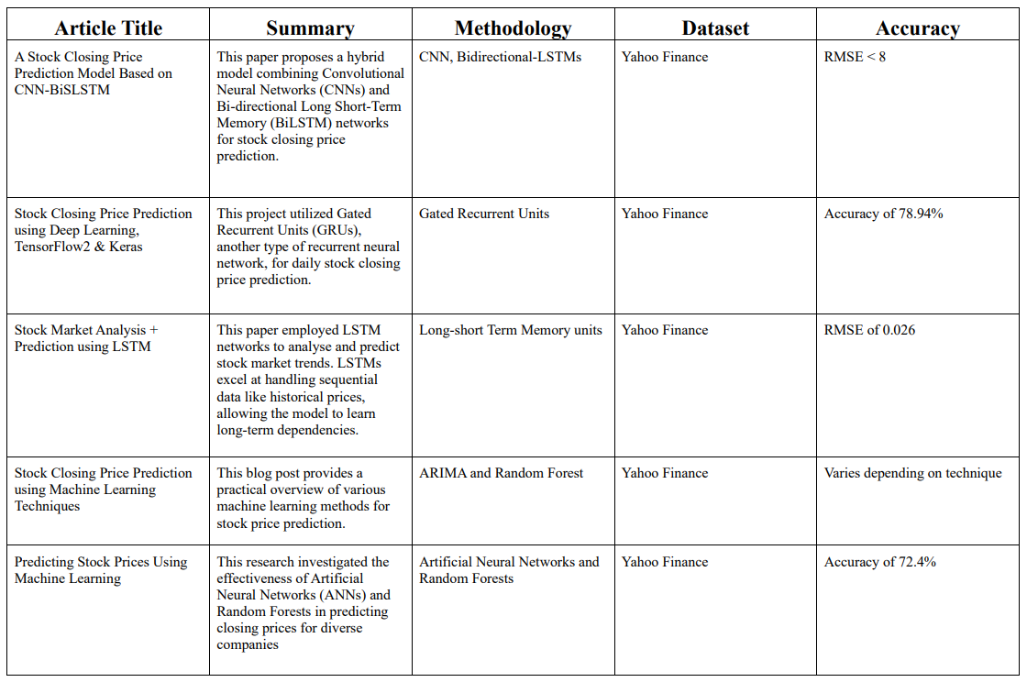
LITERATURE REVIEW

Slide 14
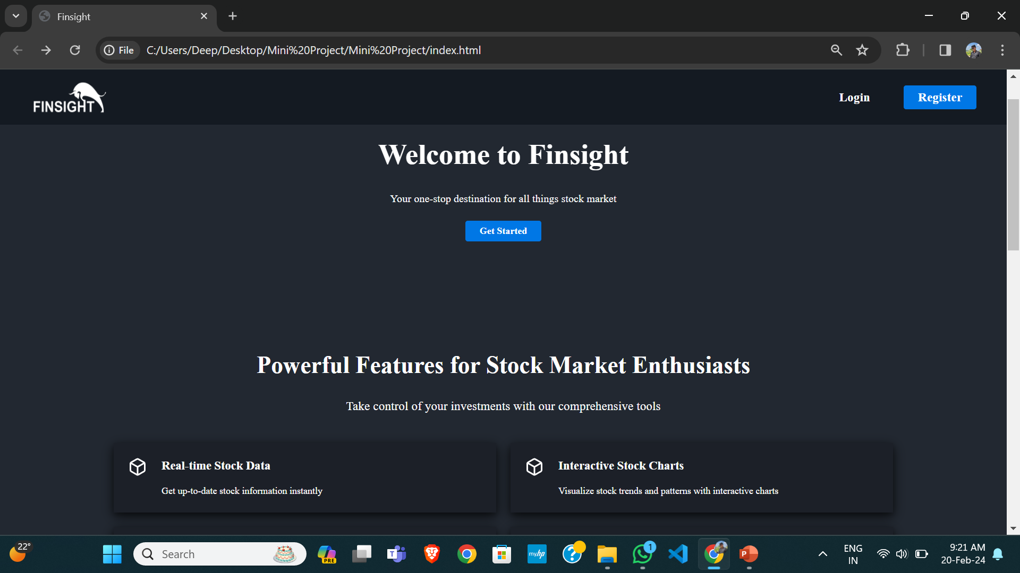
Index Page
This is the page where user first lands whenever he/she opens the site. This page provides the general overview. User needs to log-in/sign-up for using the tools.

Slide 15
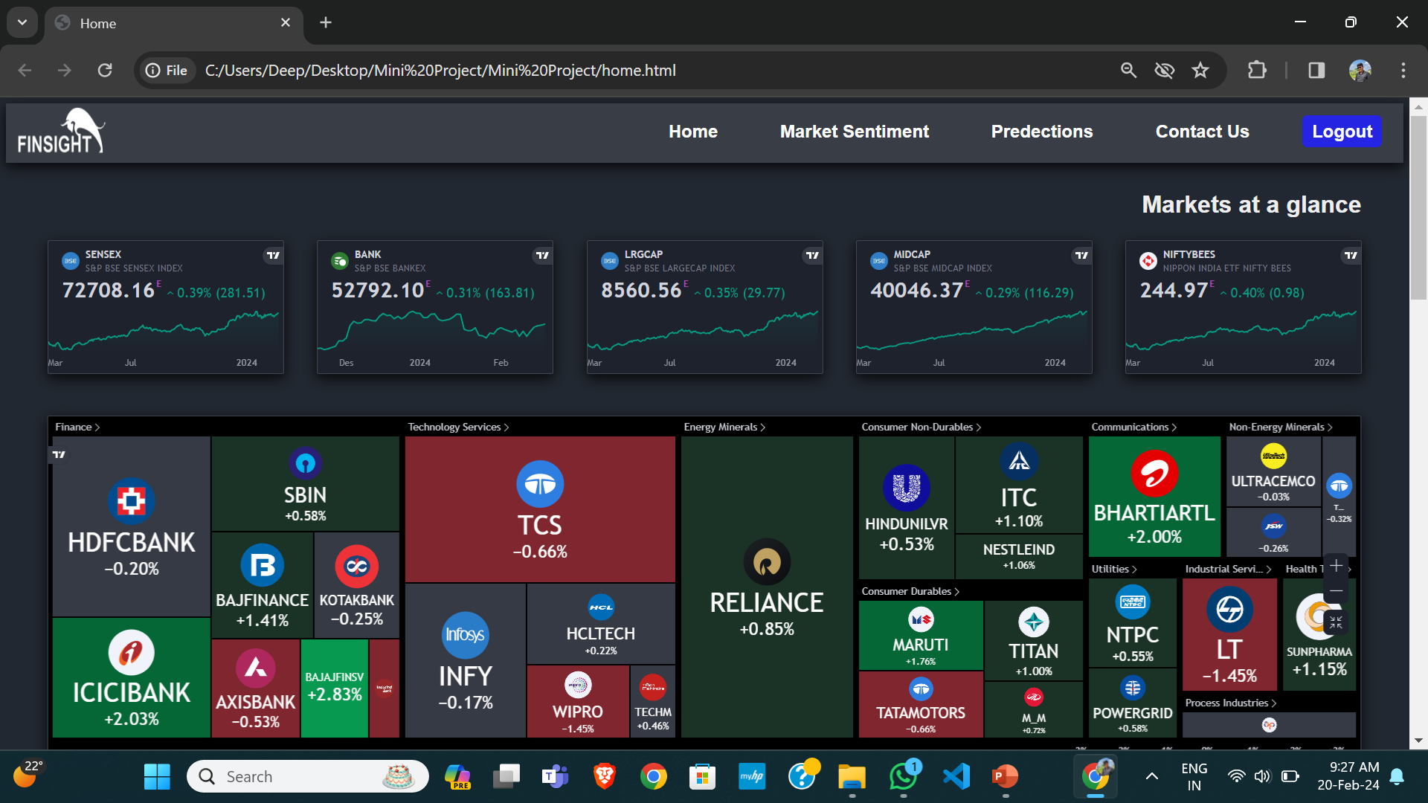
Home Page
This page provides users with general overview of the current market. It contains various indices and stocks of Indian market.
It also contains the graph of any particular stock along with the financial of that particular company.

Slide 16
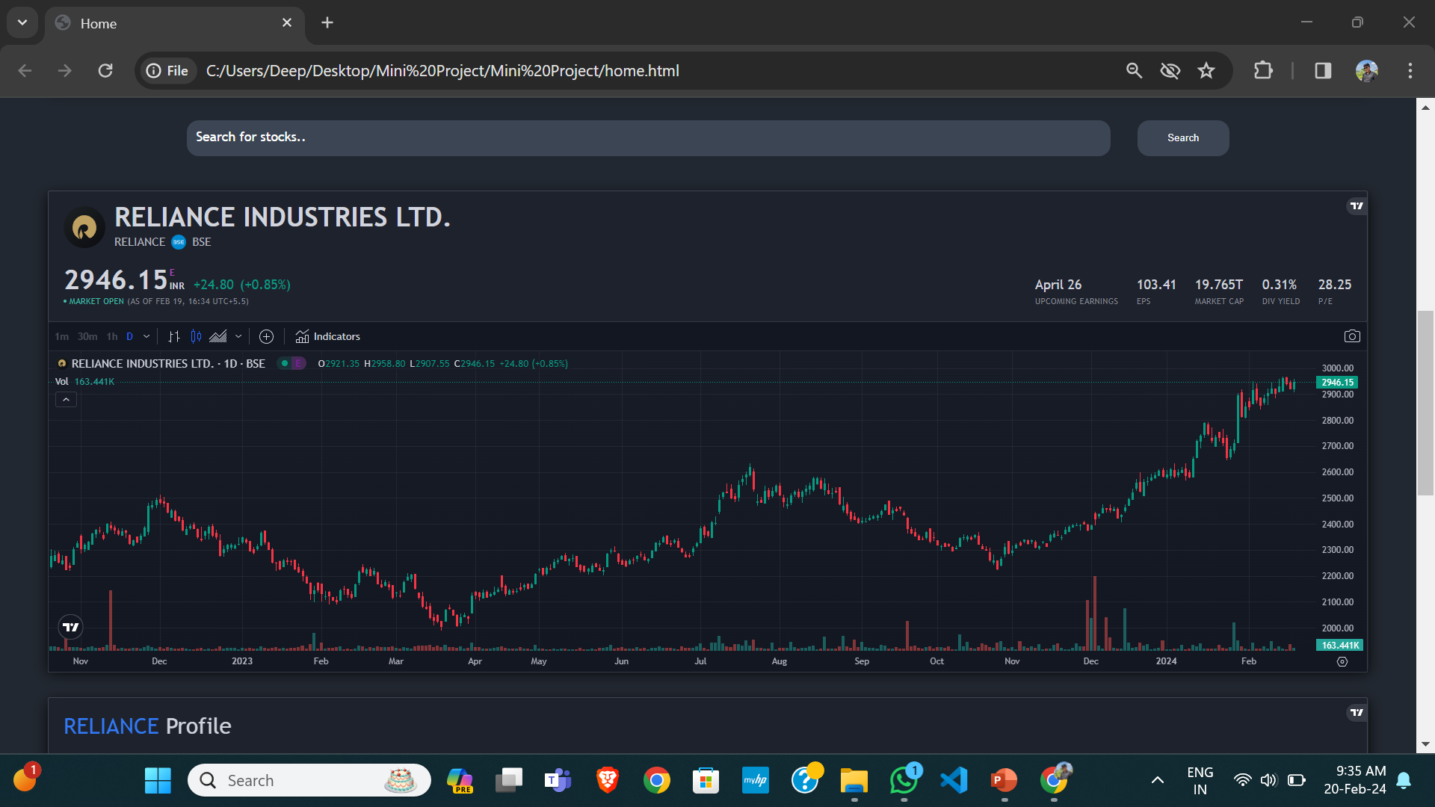
Home Page
This page provides users with general overview of the current market. It contains various indices and stocks of Indian market.
It also contains the graph of any particular stock along with the financial of that particular company.

Slide 17
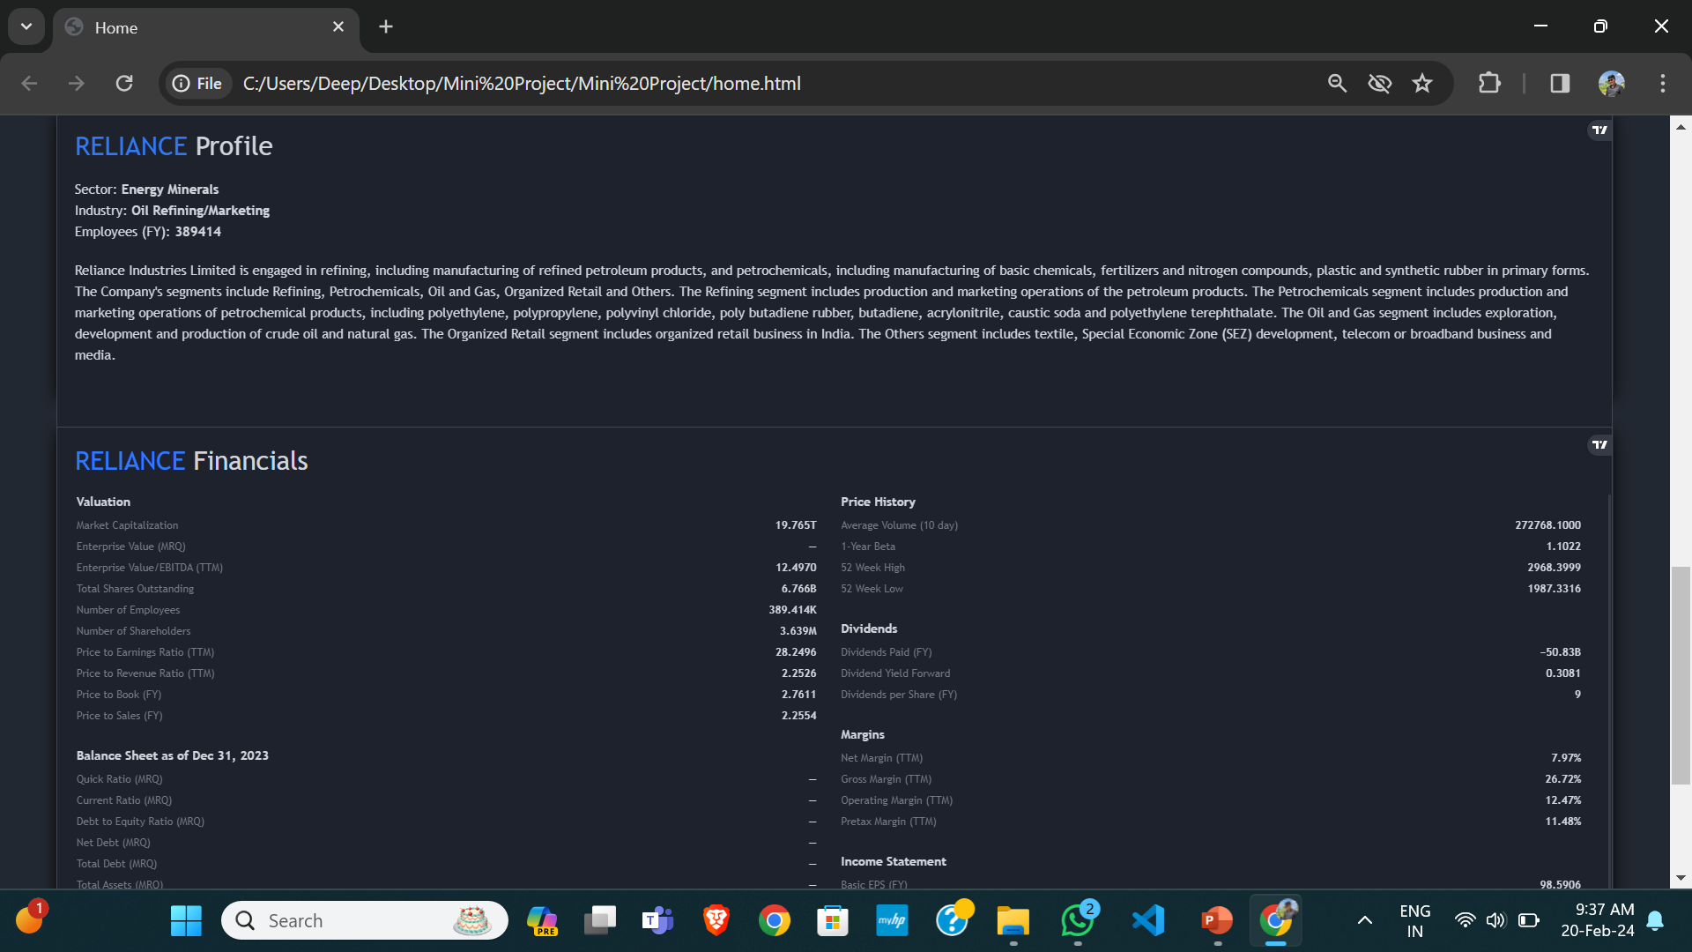
Home Page
This page provides users with general overview of the current market. It contains various indices and stocks of Indian market.
It also contains the graph of any particular stock along with the financial of that particular company.

Slide 18
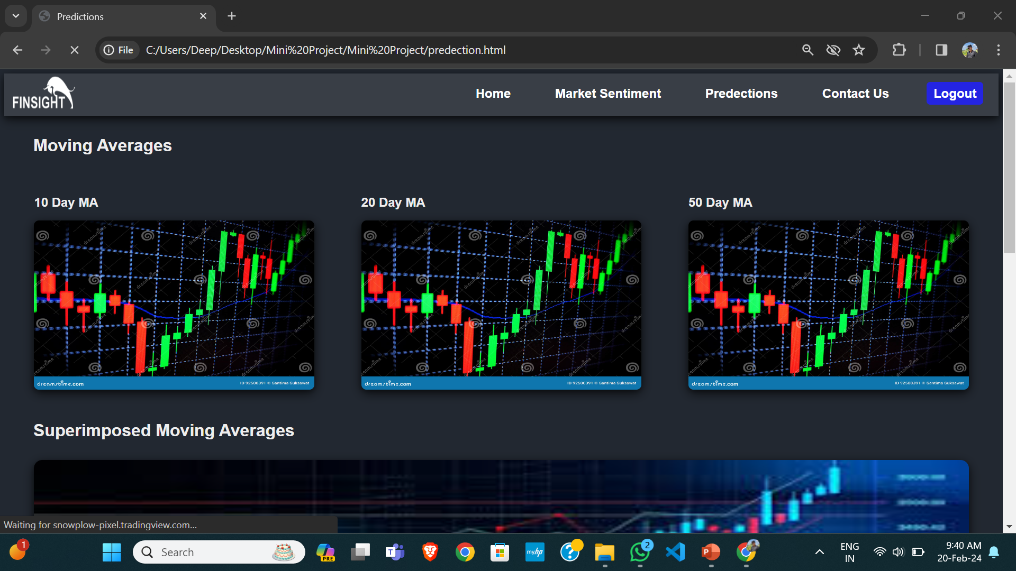
Prediction Page
A prediction page contains the moving averages, SMA and the prediction of the share price upto next two months.
This predictions are made on the basis of historical data and movements in the stock price.

Slide 19
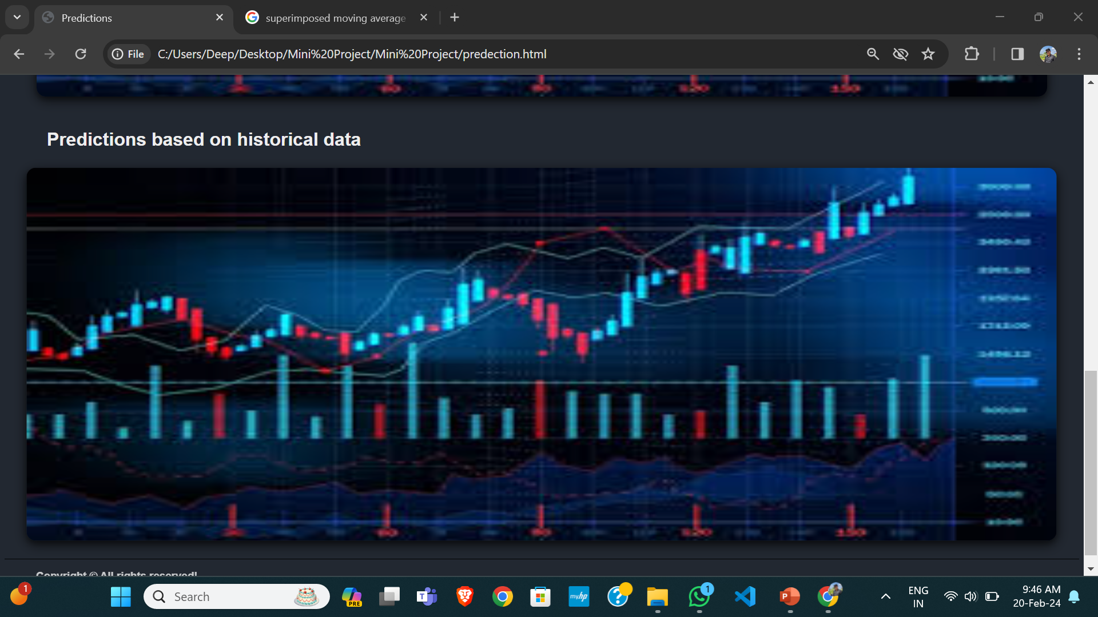
Prediction Page
A prediction page contains the moving averages, SMA and the prediction of the share price upto next two months.
This predictions are made on the basis of historical data and movements in the stock price.

Slide 20
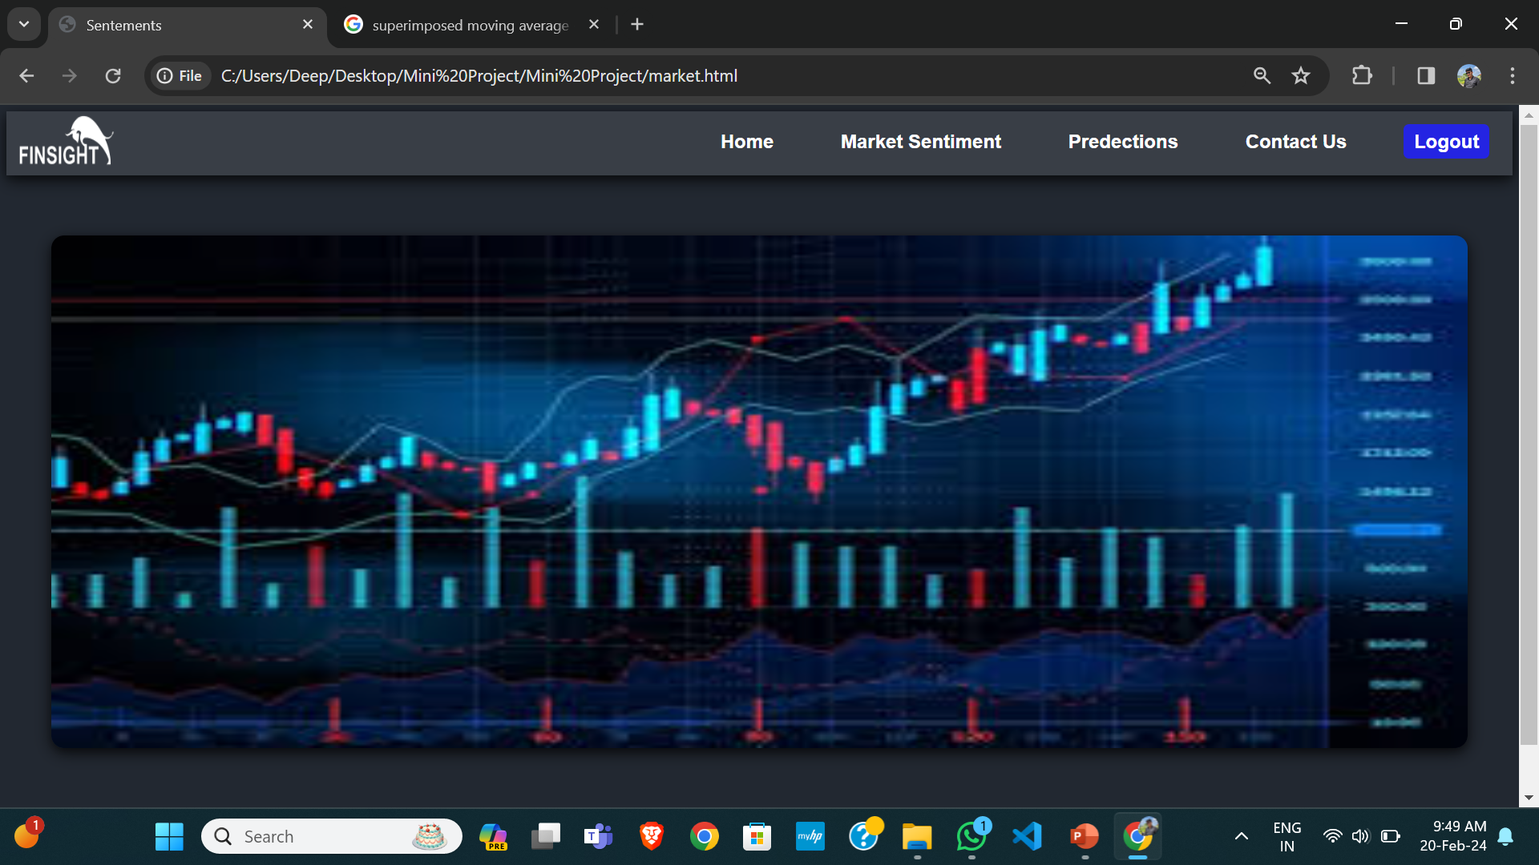
Market Sentiments
This page provides the information about the overall mood of the brokers and investors about a stock or the stock market as whole.

Slide 21
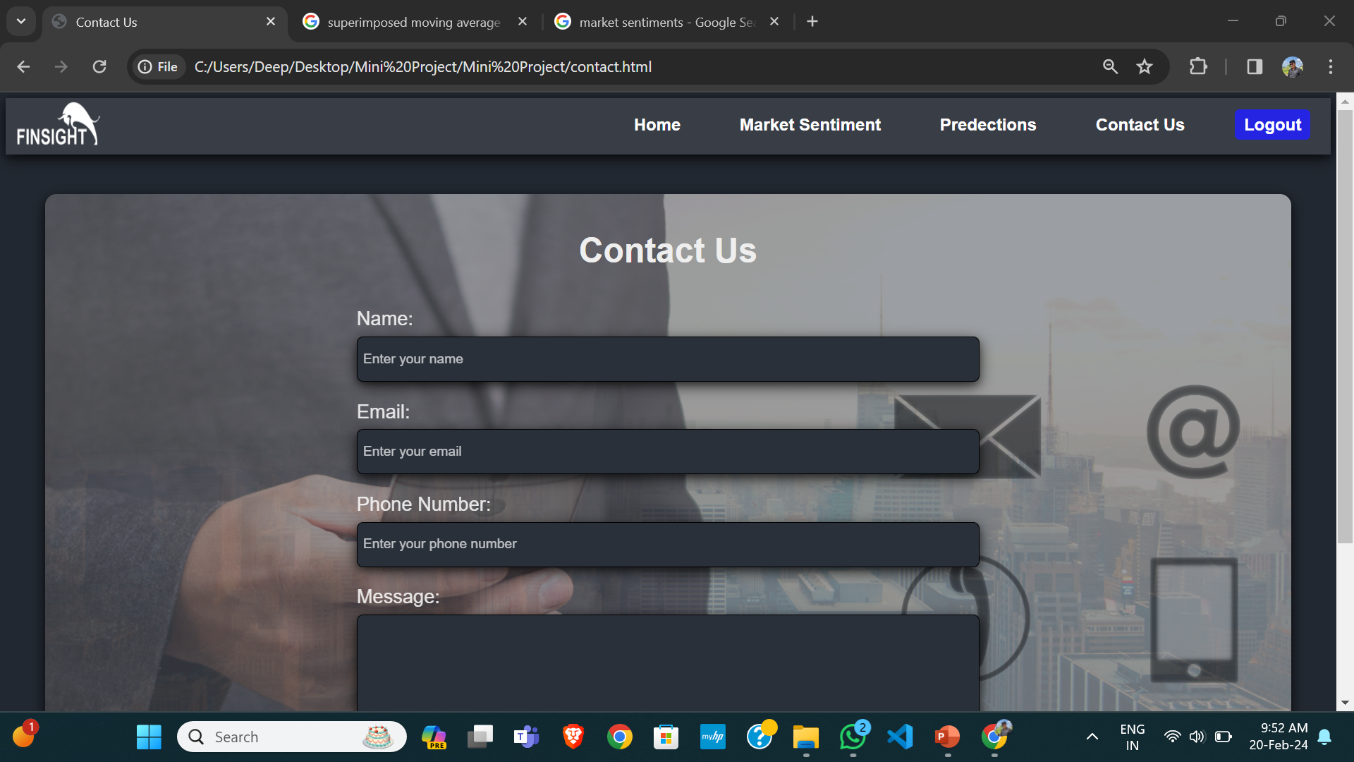
Contact Us
This page allows the users to interact with the admin for asking their doubts, for any suggestions regarding the predictions or for any complain due to improper functioning of the tools

Slide 22
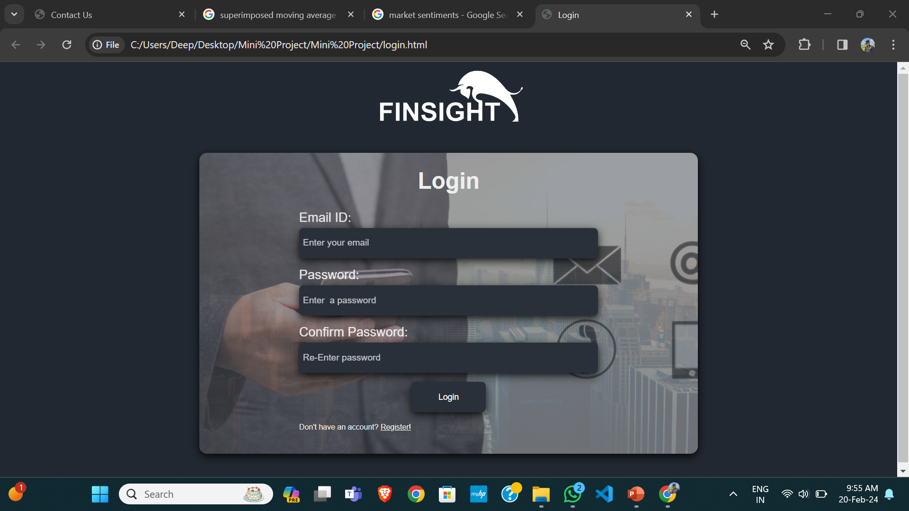
Sign-in
A sign-in page is that allows users to log into their existing account on a website. The page typically includes a form that prompts users to enter their login credentials, such as their email address and password.

Slide 23
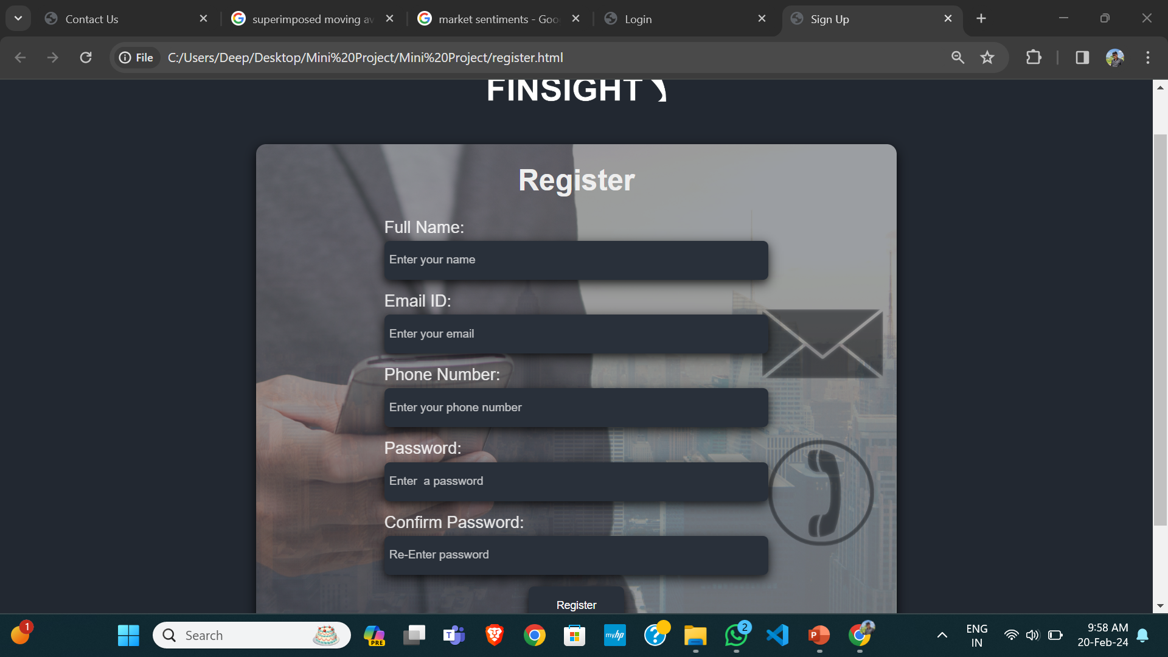
Sign-up
A sign-up page is that allows users to create a new account on a website. The page typically includes a form that prompts users to enter their personal information, such as their name, email address, and password.

Slide 24

WORK DISTRIBUTION
Connecting front-end and back-end with Django. Setting up relevant data transfer methods for efficiency
Development of web page templates using HTML, CSS, JS, etc..
Development of ML models, their training, testing etc. Applying various data preprocessing techniques
Deep Hirapara
Vatsal Patel
Pratham Satani

Slide 25

CONCLUSION
In conclusion, our presentation has shed light on the development of a frontend project focused on stock market prediction. Our project integrates various frontend technologies and data visualization techniques to provide users with an intuitive platform for analyzing stock market trends and making predictions. By incorporating interactive charts and user-friendly interfaces, we aim to enhance the user experience and facilitate efficient navigation through complex financial data.

Slide 26


THANK YOU FOR YOUR TIME!

